Slide 1
Wall Crack Detection
Course Instructor : Dr V Hrishikesh V Raman

Slide 2
Team Members
Harshini Sai M - S20200010119
Jaswanth Krishna - S20200020257
Divya. M - S20210020268
K Viswanath Reddy - S20200010086

Slide 3
Problem statement
Cracks in walls pose a significant threat to the structural integrity of buildings and can lead to costly repairs if left undetected.
Traditional methods of crack detection, such as manual inspection, are time-consuming, subjective, and prone to human error.
The development of an automated crack detection system that can accurately classify scratched paint and cracks is crucial for ensuring the safety and longevity of buildings.

Slide 4
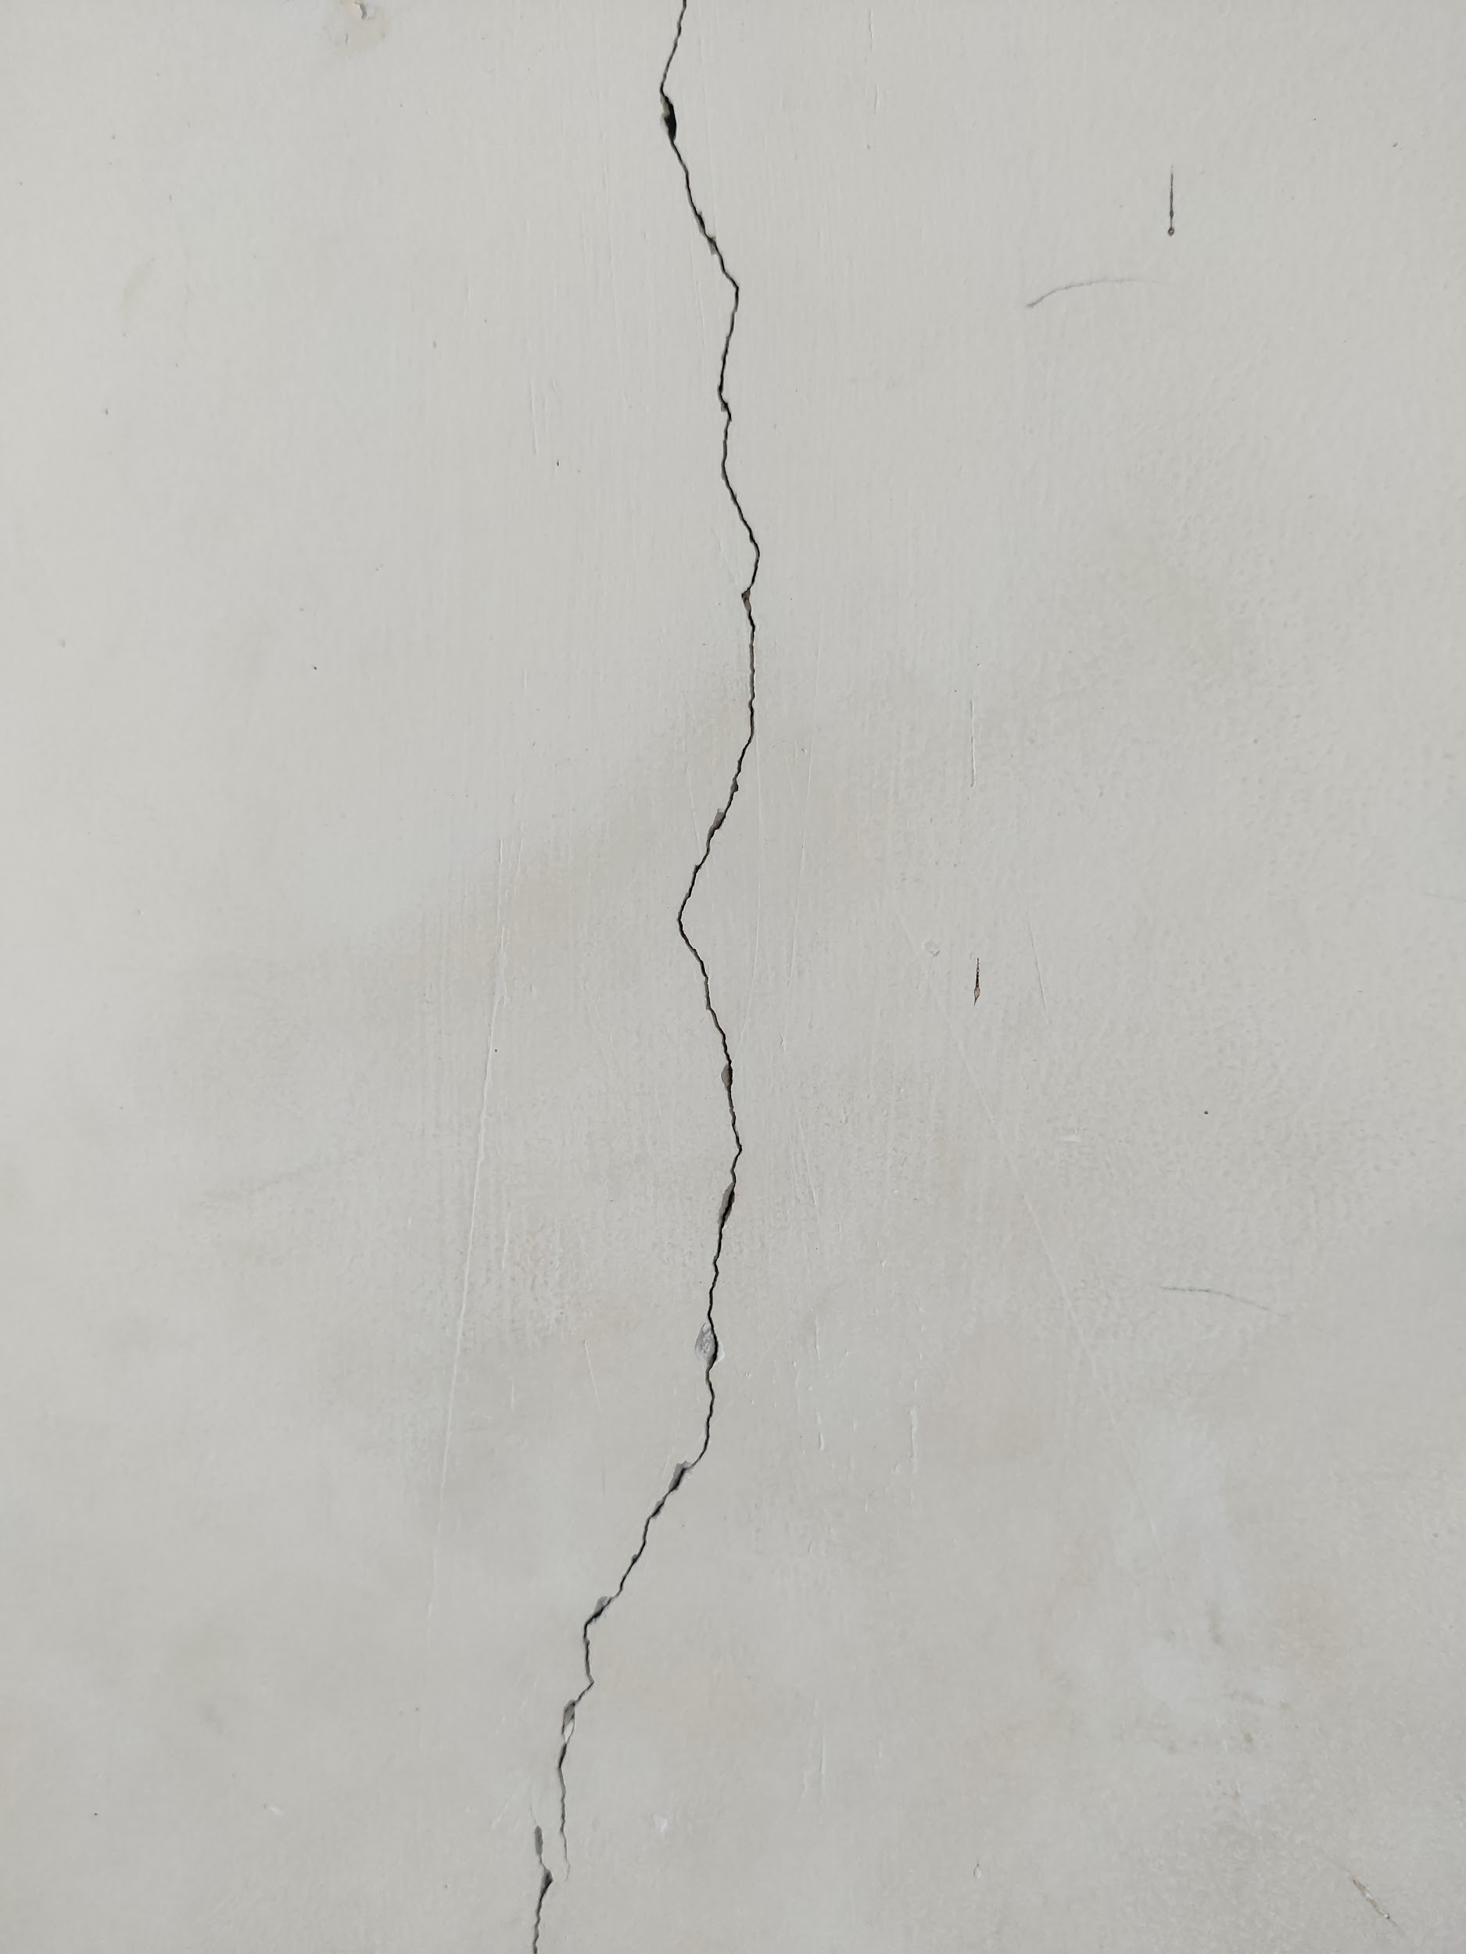
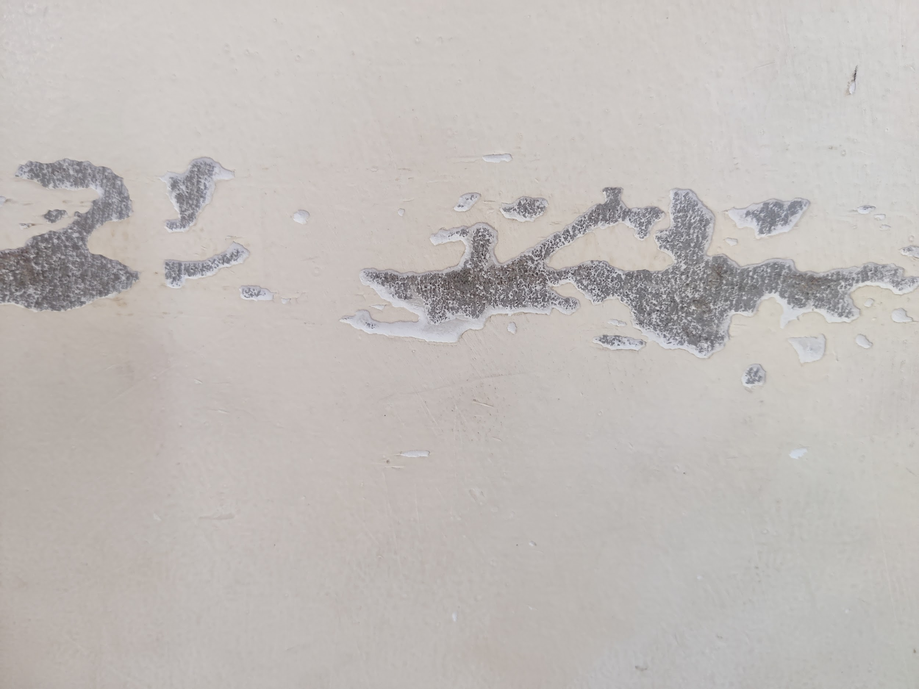
Classification
Wall Crack
Scratched Paint

Slide 5
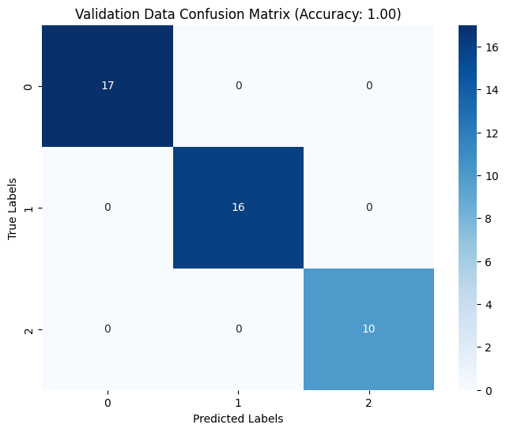
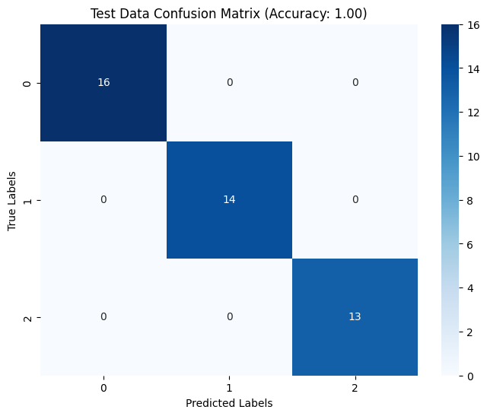
Classification Results

Slide 6
You only look once - Yolo V8
Dataset | Images | Percentage
Test | 429 | 87%
Validation | 48 | 8%
Test | 48 | 5%

Slide 7
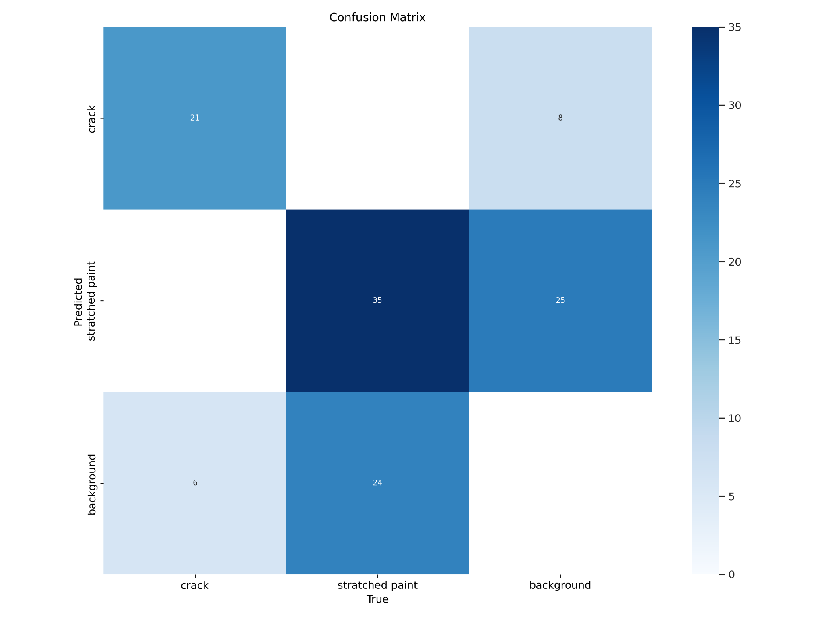
Confusion matrix
21
8
35
25
6
24

Slide 8
Results
The model is good at detecting and classifying cracks in naked walls with a mean Average precision of 66.9%.
The model can be made even better by training it with more data and adjusting its settings.
We have deployed a yolo model using python in local machine.
This model work only on the walls without any other objects in the frame.

Slide 9
Thank You

